Slide 1
Network Forensic Analyzer Project
Kade Whitman
CPSC495: Computer Science Seminar

Slide 2
Project Overview
Goal: Build a tool in Python to analyze DNS traffic, detect suspicious behavior, and make a GUI for end users to use
Tools used: Wireshark, Python, Pyshark import, Tkinter import
Why: DNS traffic is a common place to find suspicious activity that leads to cyberattacks. Having an easy way to view it can help investigator spot threats
This aligns with my career goal of working in Cybersecurity and Digital Forensics

Slide 3
Understanding Packets
Every time you surf the internet, your computer sends messages into the network called packets
Hackers can hide data in these packets that can be malicious towards your computer. Digital forensics investigators need tools to spot this suspicious behavior
Based on the websites and software you use in a session, hackers can create malicious data that your computer will reach out to get

Slide 4
What is DNS?
DNS is like the phonebook of the internet
When you visit a website like Google, DNS will look up the phone number (IP address) of that website so your computer knows where to go to access the network and render the website
Every time you visit a website, your computer sends a request for the DNS to find out where to go
We look at DNS activity because hackers like to hide data and redirect network traffic using DNS

Slide 5
Phase 1: .pcapng Files
The Wireshark packets are stored in .pcapng files
PCAP files are the universal format for storing network packet data
The ng that is added stands for “next-generation,” which is a newer format that is modular, more flexible, and stores more data

Slide 6
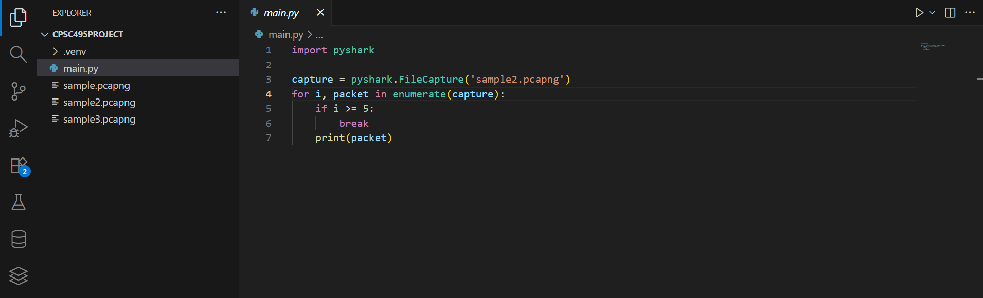
Phase 1: Code
Import pyshark loads the pyshark library, which syncs python with Wireshark’s command line tool, tshark, makes reading .pcapng files possible in Python
Variable “capture” performs a fileCapture on whatever .pcapng file you want to read
For loop that tracks index i, calls variable ”capture”. Enumerate counts how many packets are processed in a single .pcapng file
If statement with break stops the for loop after 5 packets to prevent terminal flooding
Print(packet) prints the raw data we can analyze

Slide 7
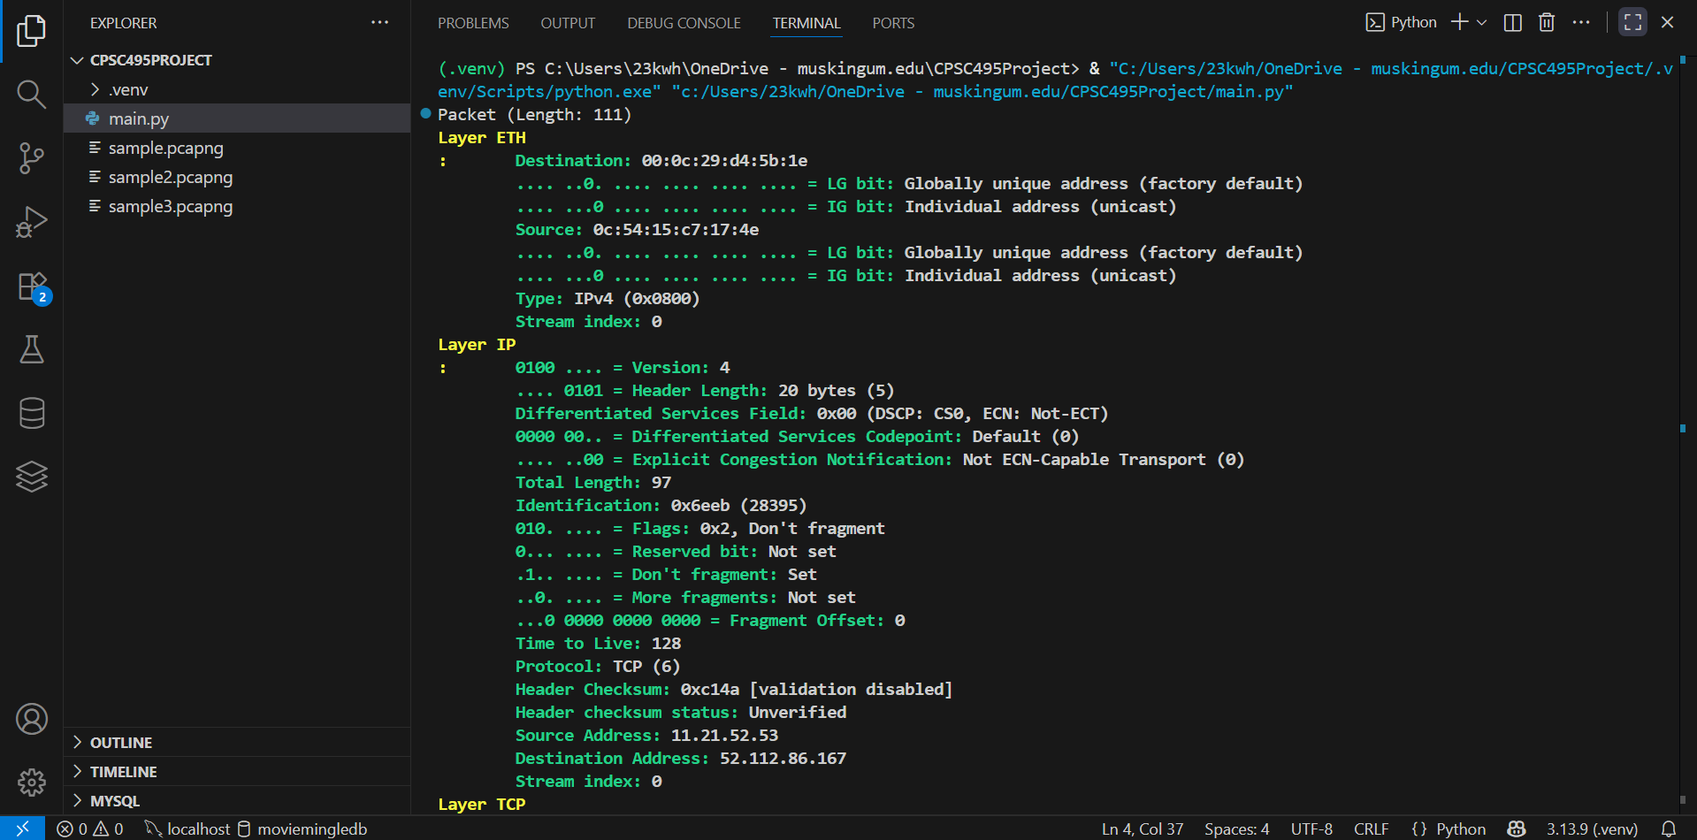
Phase 1: Output
The packet is 111 bytes long. It has four layers
Layer ETH/Ethernet (Pictured): Shows physical MAC addresses. They identify hardware used on the local network
Layer IP/Internet Protocol (Pictured): Gives us the source and destination IP addresses, and the Don’t Fragment means that the packet must arrive whole
Layer TCP/ Transmission Control Protocol: Shows the ports used to manage the connection. Shows that the web session is secure and the content is encrypted
Layer TLS/Transport Layer Security: Encrypts the actual content. Application data is the data used by whatever applications the user is on. 52 bytes of encrypted data is good, likely because I went on Google, which has a secure HTTPS connection

Slide 8
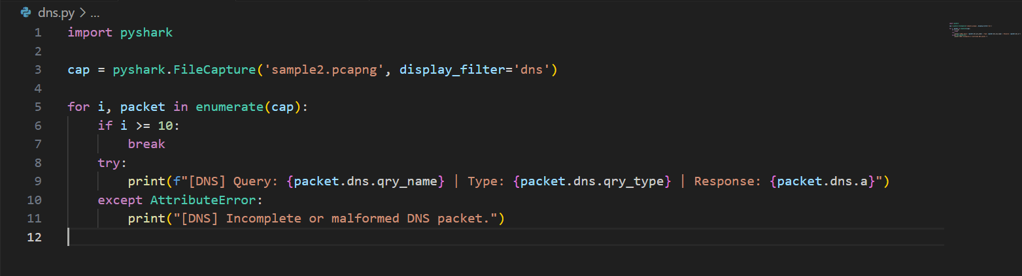
Phase 2: Code to Extract DNS Traffic
The try-except block is the main code that extracts and prints out the DNS traffic
It prints the query, the type, and the response
EXCEPT if the DNS packet is incomplete

Slide 9
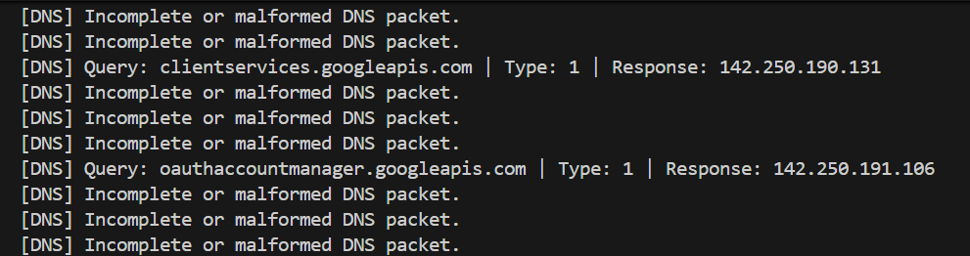
Phase 2: Output of Extracting DNS Traffic
Query: The website address
Type: What type of DNS record it is. Type 1 is IPv4 Address
Response: The IP address that is being returned from this response

Slide 10
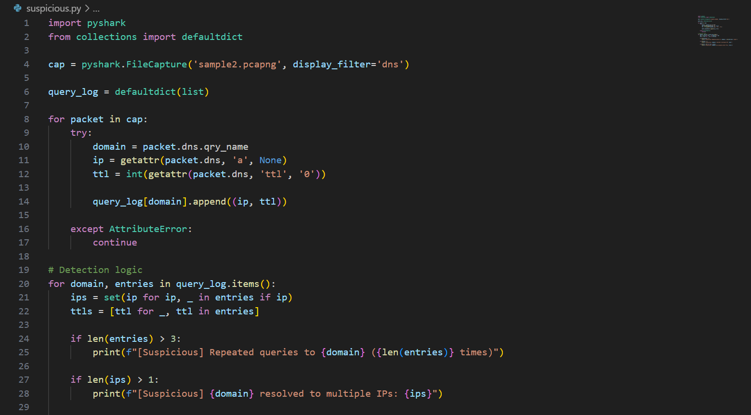
Phase 2: Code for Detecting Suspicious Patterns
Cap variable grabs packet and filters DNS info
Query_log creates the list to store each “suspicious” log
Domain, Ip, and ttl pull out the domain name, the IP address, and the time-to-live (the amount of time the computer should remember a DNS response)
Appending the ip and ttl of the query_log means to add that information to the log
Detection logic: If statements consider suspicious activity as either repeated queries to the same IP, multiple Ips used in one domain, or short TTLs

Slide 11
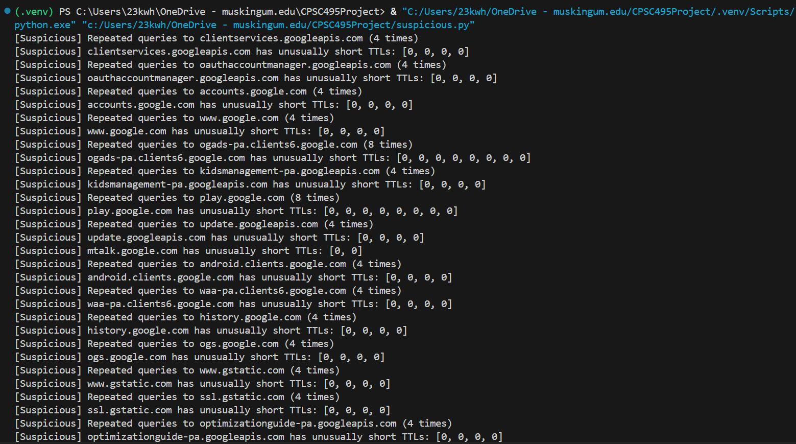
Phase 2: Output of Detecting Suspicious Patterns

Slide 12
Phase 2: Why just Visting Google Causes Flags
Repeating Queries from Visiting Google is because of the many subdomains a global website like Google uses
Because Google is global, IPs may point to many different locations, causing multiple IPs to be captured
Low TTLs for a major website like Google are used to optimize and improve performance

Slide 13
Phase 3: Report Generation
Problem: Raw Forensic Data captured can be hard for end users to understand
Solution: Create a structured forensic report for the end user
Features: Timestamped Reports, Split into each Domain, and a clear lift of suspicious behaviors

Slide 14
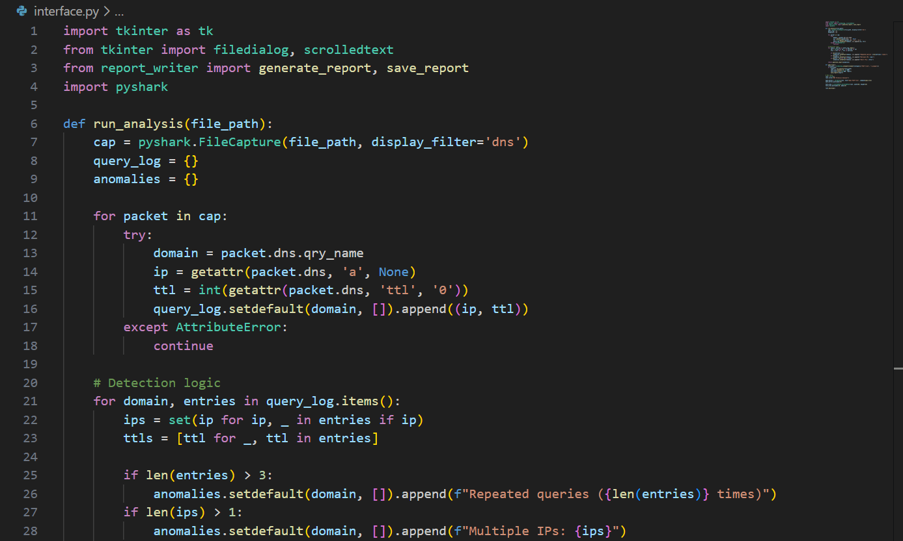
Phase 3: Code
Tkinter import for GUI, imports the filedialog font, and scrolling for the report in the GUI
Def run_analysis captures and opens the PCAP file and filters out the DNS
For packet in cap section reads each DNS packet one by one
Detection Logic runs

Slide 15
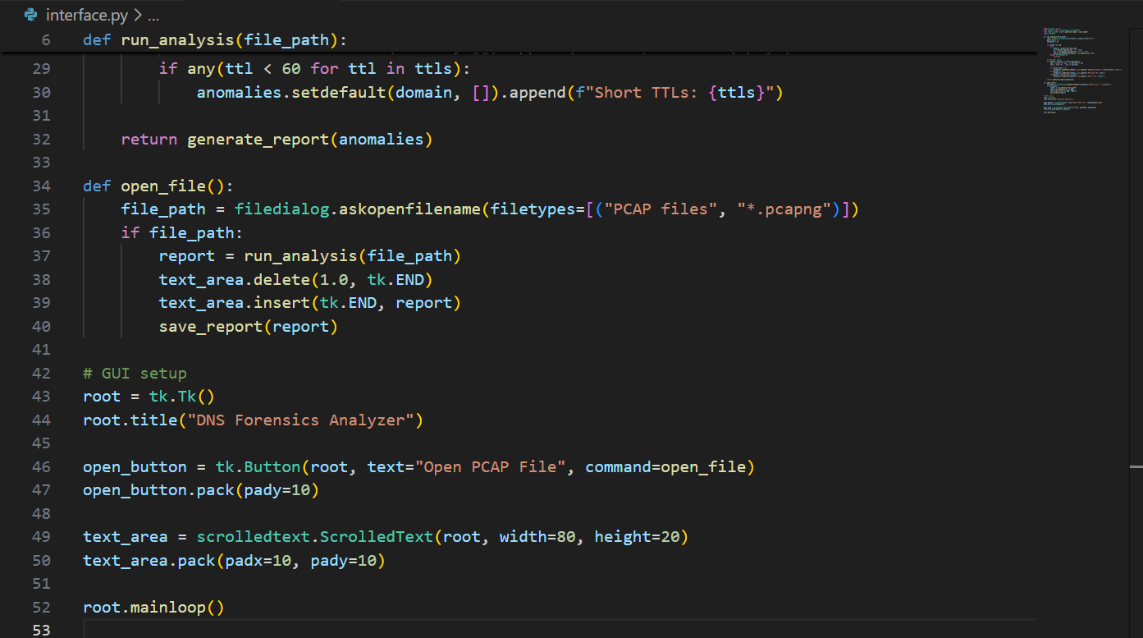
Phase 3: GUI Code
The rest of the detection logic at the top
Def open_file is the logic so the end user can select a file from their computer
GUI setup: renders GUI that allows selecting a file. Report them prints in a scrollable box

Slide 16
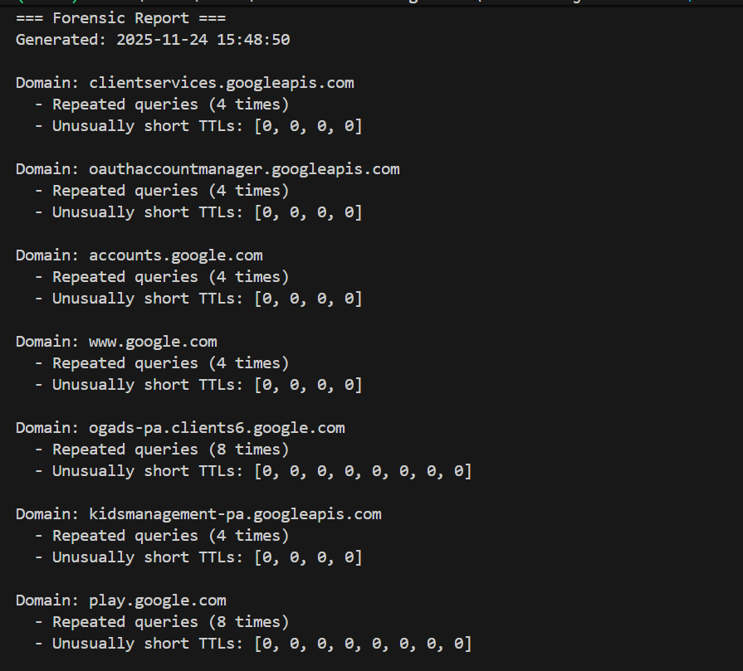
Phase 3: Report Output
The report is easy to read
Shows the anomalies and their reason for being anomalies
Readable for an end user who wants to know the security risks of certain websites or online programs they are visiting
Ran into issue of TTL values of 0 being returned

Slide 17
Phase 3: TTL Values returning 0
Problem: TTL values would always return as 0, causing them to appear in the report since the value was below 60
Reason: TTL values are only present in the DNS response itself. My code captures just queries, causing the TTL field to be empty, defaulting to 0

Slide 18
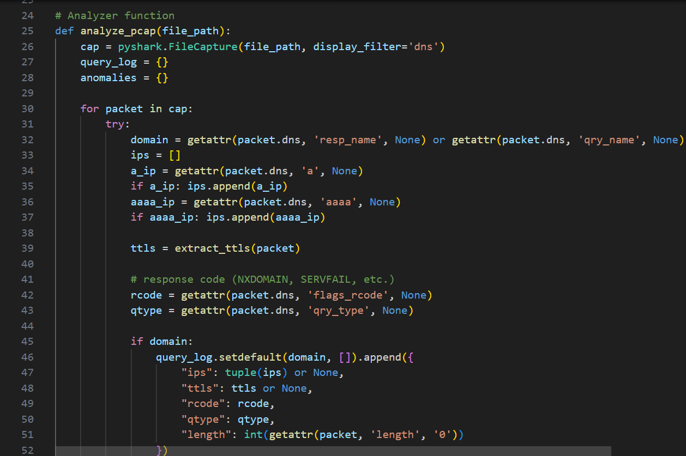
Phase 3: Solution to this Problem
Step 1: Add dns.flags.response to the display_filter
Step 2: Change the 0 return to “None”
Step 3: Create an if-else statement to handle multiple TTLs

Slide 19
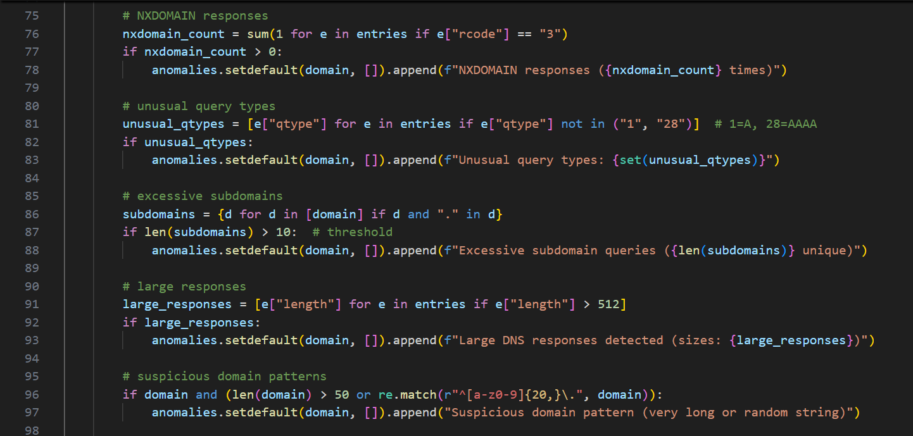
Phase 3: Extra Anomalies
Added more data that can be flagged as suspicious activity
Added Non-existent domain reads. Hackers use these non-existent domains and convert them into channels that can be contacted
Unusual query type flag: If type A (IPv4) or type AAAA (IPv6) aren’t returned, an unusual query type flag will occur to warn of DNS tunneling
Excessive subdomains: some of those subdomains could be used by hackers for extracting DNS data
Long domain name check: Trusted websites usually have short and clean domain names

Slide 20
Phase 3: GUI Interface
Problem: Viewing these reports in the terminal is not user-friendly
Solution: Build a simple GUI using tkinter, a python-based GUI tool
Features: Button to select .pcapng file from your files, runs immediately after being selected, and displays the report in a scrollable user-friendly text box

Slide 21
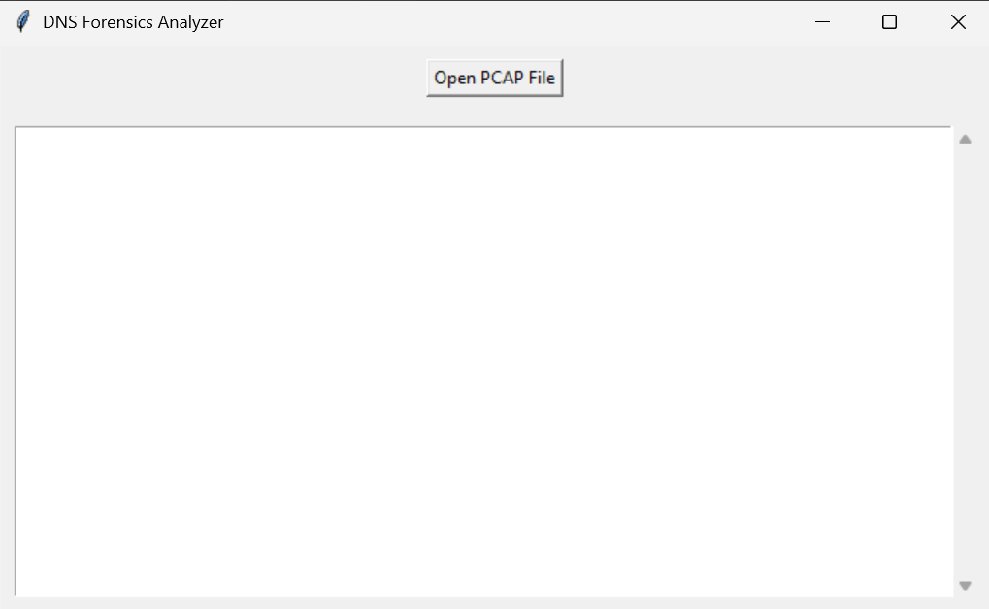
Phase 3: GUI Output

Slide 22
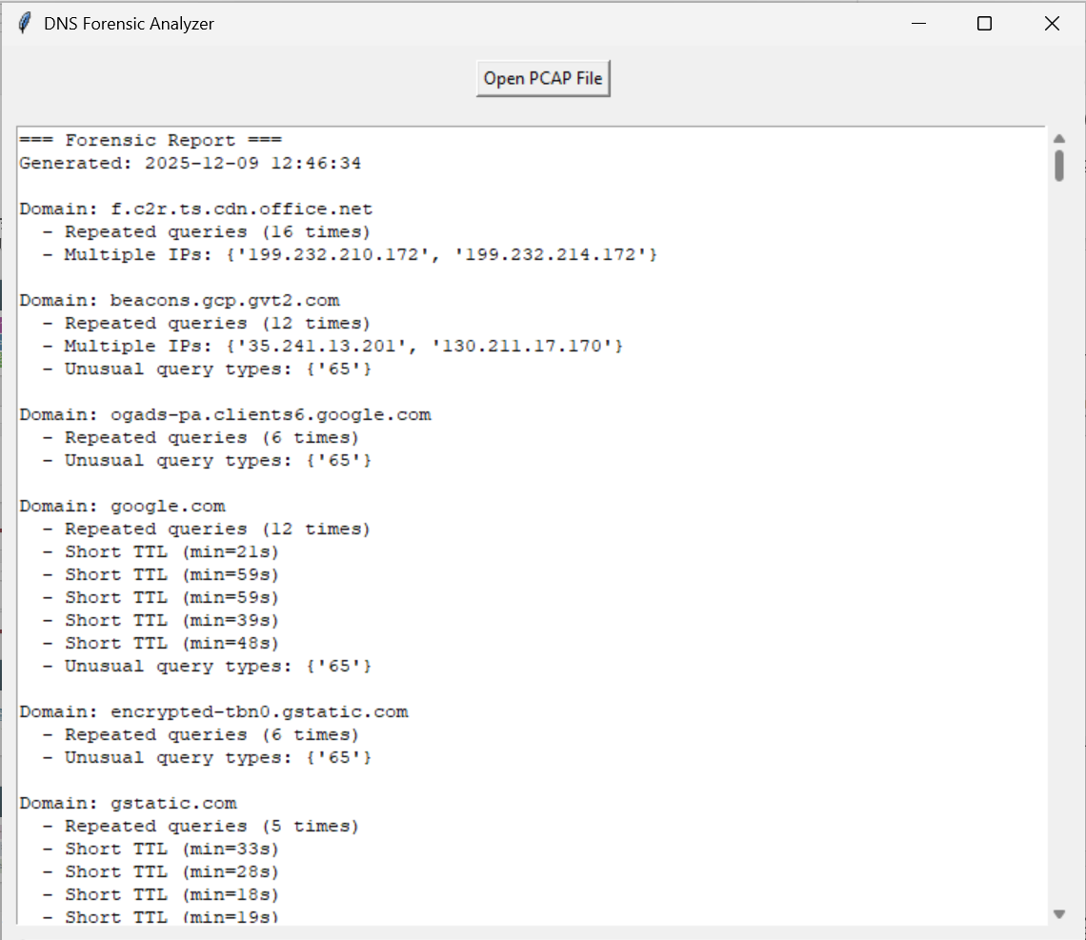
Phase 3: GUI Output with Report
This is the top part of a packet where I visited CNN, Amazon, Facebook, Youtube, OneDrive, and Outlook

Slide 23
Phase 3: Why use a GUI?
Reports make the data understandable for end users
The GUI makes the tool usable for anyone
Report itself -> Prototype
Report in GUI -> Forensic Tool with Real Application

Slide 24
Other Challenges and Solutions
Challenge 1: Learning Wireshark from Scratch
Solution: Research and Videos
Challenge 2: False Positives
Solution: TRUST NOTHING. Treat these positives like any other. Cybersecurity is important. Do research as to why the positive shows up and clear it.
Challenge 3: Thinking like an end user
Solution: When designing the GUI, I pretended I had no knowledge on the subject. Made the GUI a simple and usable as possible

Slide 25
What I Learned
Technical Skills:
DNS Traffic Packet Analysis
Anomaly Detection
Using Python in a real-world application
Professional Skills:
Modular Design in coding and organization
Understanding the importance of usability
Connecting academic work to career goals

Slide 26
Thank you

